Slide 1


Monetary Policy Committee
Monetary Policy Report August 2021
Annex: Other forecasters’ expectations

Slide 2
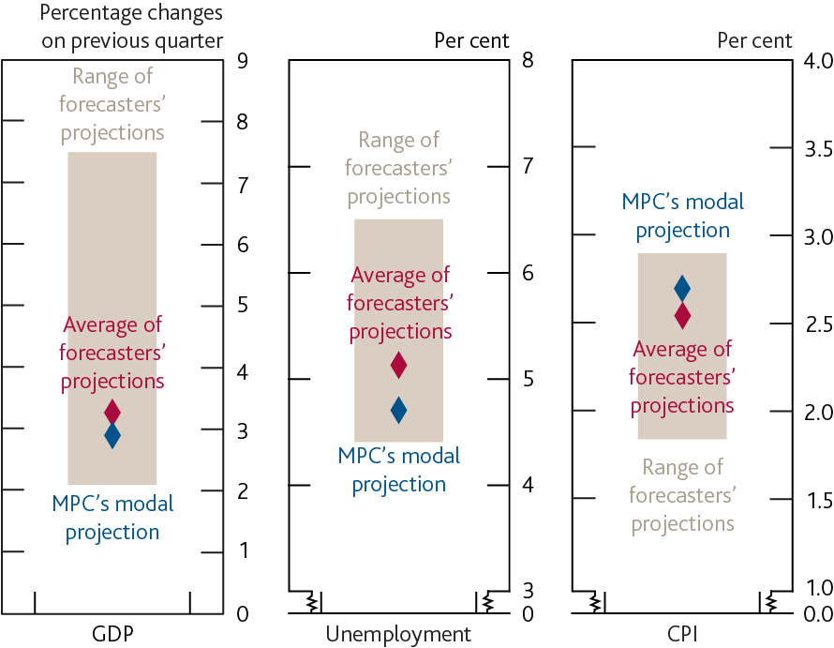
Chart A: On average, external forecasters expect GDP to rise by 3.3% in 2021 Q3, the unemployment rate to rise to 5.1%, and CPI inflation to increase to 2.5%
Other forecasters’ central projections for GDP, the unemployment rate and CPI inflation in 2021 Q3

Slide 3
Table 1: Averages of other forecasters’ central projections
(a) Four-quarter percentage change.
(b) Twelve-month rate.
(c) This projection is markedly affected by one respondent. Excluding that respondent from the sample, Bank Rate is expected to be 0.1% in 2022 Q3, 0.3% in 2023 Q3 and 0.7% in 2024 Q3.
(d) Original purchase value. Purchased via the creation of central bank reserves.
(e) Index: January 2005 = 100.

Slide 4
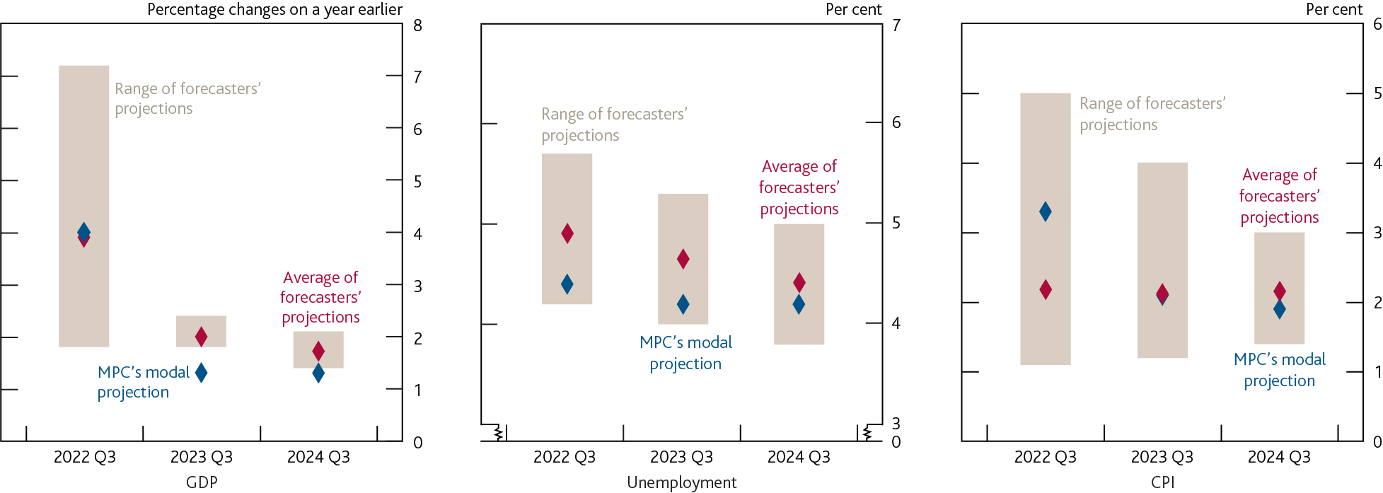
Chart B: At the three-year horizon, external forecasters expect annual GDP growth to be 1.7%, the unemployment rate to be below 4.5%, and inflation to be close to the MPC’s 2% target
Projections for GDP, the unemployment rate and CPI inflation

